Slide 1
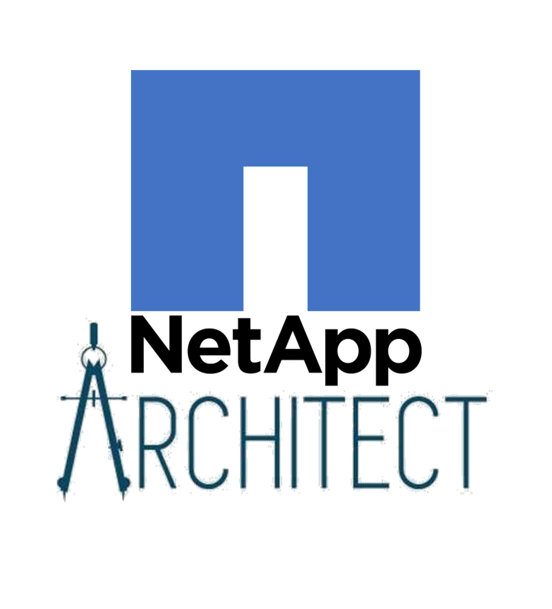
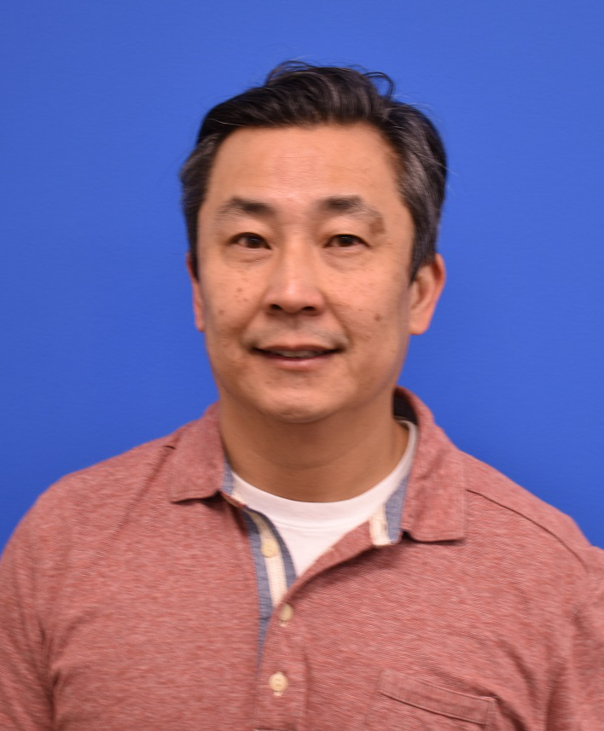
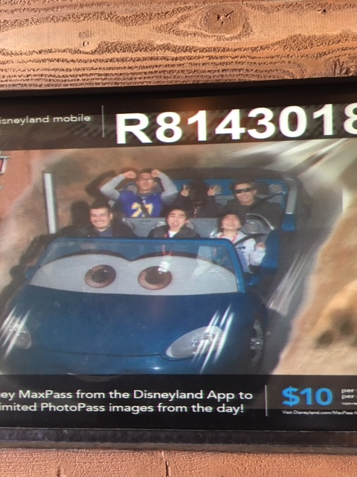
Architect Introduction: Ivan Hom
Background
Time at NetApp | Just joined
Experience Before NetApp | Bank of New York Mellon Other companies for 20+ years in data science and software development
Fun Facts
Family | Family of 4
Enjoy | Exercising, reading and playing with dog
Focus
Architect Role | Data Science CoE
Current Projects | GrowPro / data scientist
Areas of Expertise | Data science Software development
Questions
Challenges | Building credibility for the practice of data science at NetApp
I’d Like to Know… | How we can apply NetApp technology to data science applications?

